Slide 1

OVERVIEW OF CNN

Slide 2
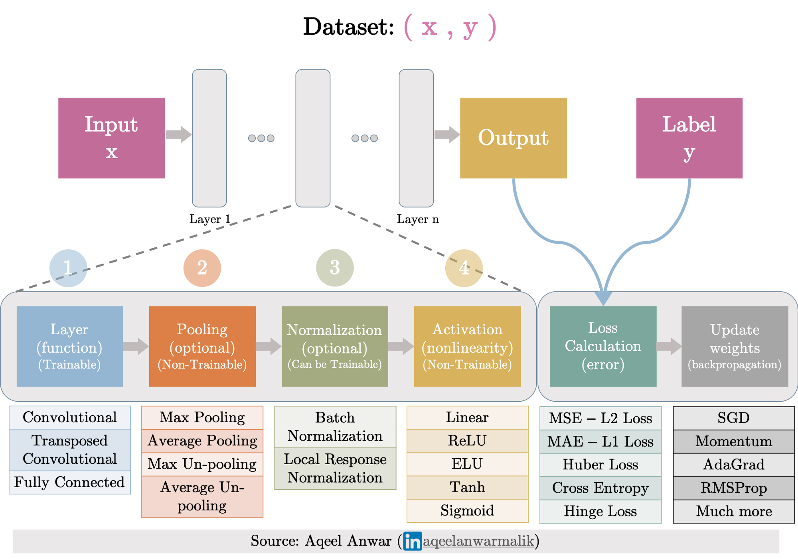
Overview CNN:
Notes:
The CNN layers we have seen so far, such as convolutional layers and pooling layers typically reduce (downsample) the spatial dimensions (height and width) of the input, or keep them unchanged. In semantic segmentation that classifies at pixel-level, it will be convenient if the spatial dimensions of the input and output are the same. For example, the channel dimension at one output pixel can hold the classification results for the input pixel at the same spatial position.
To achieve this, especially after the spatial dimensions are reduced by CNN layers, we can use another type of CNN layers that can increase (up sample) the spatial dimensions of intermediate feature maps. In this section, we will introduce transposed convolution, which is also called fractionally-strided convolution for reversing down sampling operations by the convolution.

Slide 3
Layers Types:
There are many types of layers used to build Convolutional Neural Networks, but the ones you are most likely to encounter include:
Convolutional (CONV)
Activation (ACT or RELU , where we use the same or the actual activation function)
Pooling (POOL)
Fully connected (FC)
Batch normalization (BN)
Dropout (DO)

Slide 4
Text diagram of CNN:
CNN = INPUT => CONV => RELU => FC => SOFTMAX

Slide 5
Convolutional Layer:
The CONV layer is the core building block of a Convolutional Neural Network
The CONV layer parameters consist of a set of K learnable filters (i.e., “kernels”), where each filter has a width and a height, and are nearly always square
For inputs to the CNN, the depth is the number of channels in the image (i.e., a depth of three when working with RGB images, one for each channel). For volumes deeper in the network, the depth will be the number of filters applied in the previous layer

Slide 6
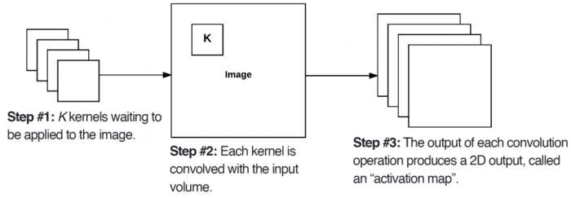
Cont.
Left: The At each convolutional layer in a CNN, there are K kernels applied to the input volume.
Middle: Each of the K kernels is convolved with the input volume.
Right: Each kernel produces a 2D output, called an activation map.

Slide 7

Cont.:

Slide 8
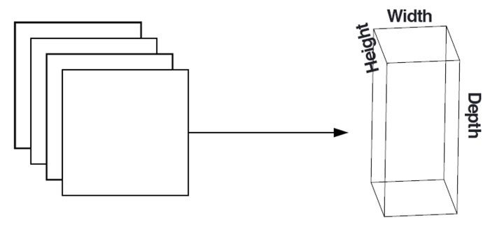
Cont.
The At each convolutional layer in a CNN, there are K kernels applied to the input volume.

Slide 9


Transposed Convolutional Layer:
A transposed convolutional layer carries out a regular convolution but reverts its spatial transformation.
An image of 5x5 is fed into a convolutional layer. The stride is set to 2, the padding is deactivated and the kernel is 3x3. This results in a 2x2 image
2D convolution with no padding, stride of 2 and kernel of 3
Transposed 2D convolution with no padding, stride of 2 and kernel of 3
Notes:
If we wanted to reverse this process, we’d need the inverse mathematical operation so that 9 values are generated from each pixel we input. Afterward, we traverse the output image with a stride of 2. This would be a deconvolution.

Slide 10
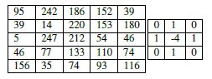
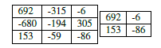
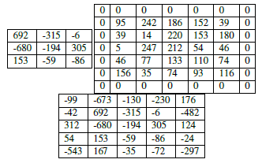
Cont.
There are three parameters that control the size of an output volume
Depth : Controls the number of neurons (filters that are “looking at” the same (x, y) location of the input is called the depth column )
Stride: A convolution operation a step of one pixel each time as “sliding” a small matrix across a large matrix, stopping at each coordinate, computing an element-wise multiplication and sum, then storing the output. (Left-to-right and top-to-bottom)
Zero-padding: Padding helps us preserve spatial dimensions
S =1
S =2

Slide 11
Cont.
Conv output = (W − F + 2P) / S) + 1
Where ‘W’ is input size, ‘F’ is filter or kernel size , ‘P’ is padding and ‘S’ is stride.
If it is not an integer, then the strides are set incorrectly, and the neurons cannot be tiled such that they fit across the input volume in a symmetric way
CNN accept input as = W_{input}×H_{input}×D_{inpu}

Slide 12
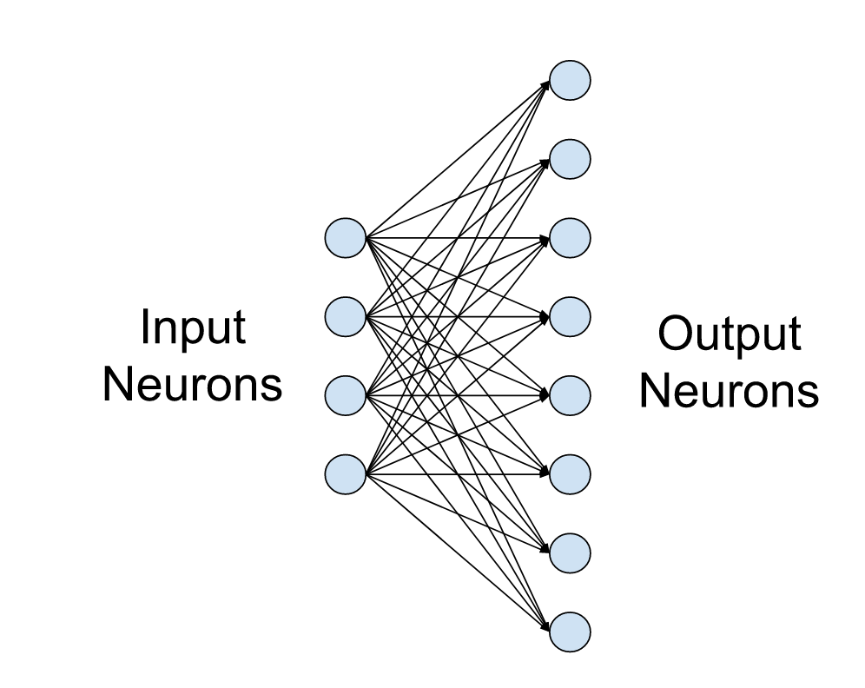
Fully-connected layer
Fully-connected layers, also known as linear layers, connect every input neuron to every output neuron and are commonly used in neural networks.
A small fully-connected layer with four input and eight output neurons.

Slide 13

Pooling Layer:
Pooling layers execute some kind of down-sample operations.
Max pooling: The maximum pixel value of the batch is selected.
Min pooling: The minimum pixel value of the batch is selected.
Average pooling: The average value of all the pixels in the batch is selected.

Slide 14
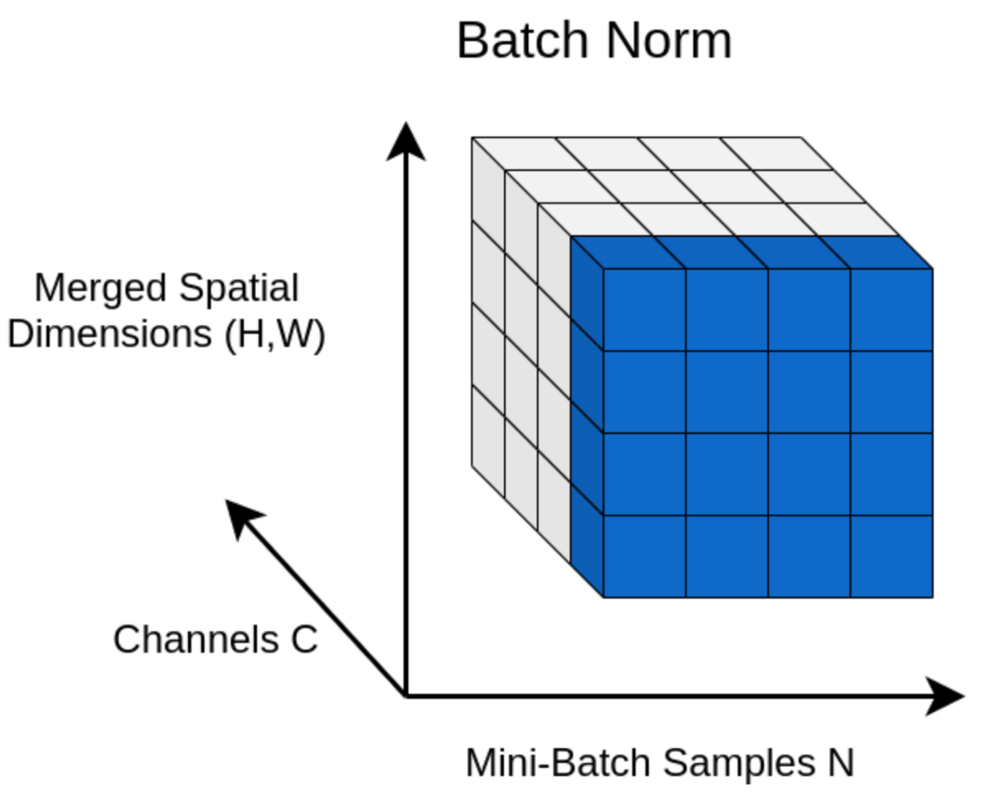
Normalization Layer
Normalization is a pre-processing technique used to standardize data.
Batch Normalization(BN):
BN layer transforms each input in the current mini-batch by subtracting the input mean in the current mini-batch and dividing it by the standard deviation.

Slide 15
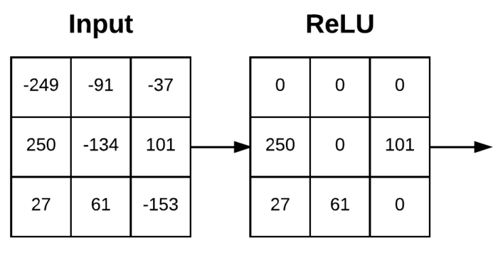
Activation Layers
After each CONV layer in a CNN, we apply a nonlinear activation function, such as ReLU, ELU, or any of the other Leaky ReLU variants
Activation layers are not technically “layers” due to the fact that no parameters/weights are learned inside an activation layer
Since the activation function is applied in an element-wise manner, the output of an activation layer is always the same as the input dimension
ReLU activation, max(0, x)
Notes:
https://www.v7labs.com/blog/neural-networks-activation-functions

Slide 16
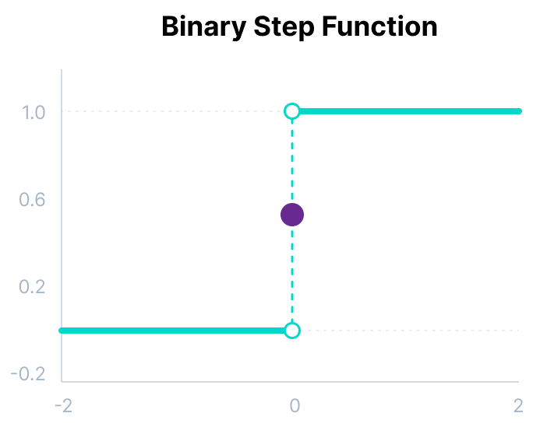
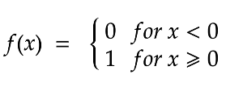
Types Activation Functions:
3 Types of Neural Networks Activation Functions:-
Binary Step Function, Linear and Non-Linear Activation Functions
Binary Step Function:
Binary step function depends on a threshold value that decides whether a neuron should be activated or no.
The input fed to the activation function is compared to a certain threshold; if the input is greater than it, then the neuron is activated, else it is deactivated, meaning that its output is not passed on to the next hidden layer.
Here are some of the limitations of binary step function:
It cannot provide multi-value outputs—for example, it cannot be used for multi-class classification problems.
The gradient of the step function is zero, which causes a hindrance in the backpropagation process.
Mathematically it can be represented as:

Slide 17
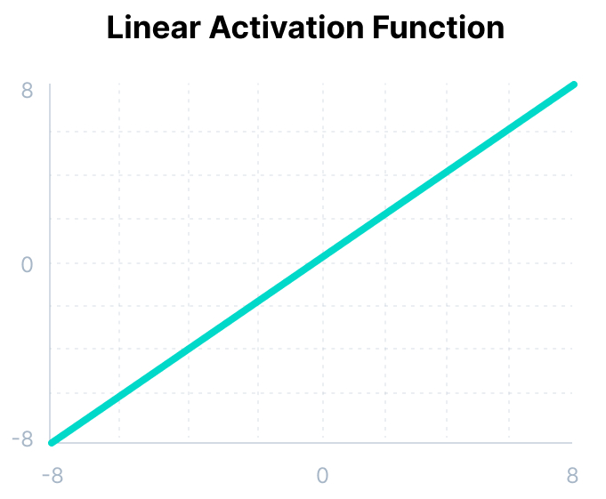
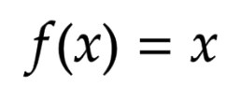
Cont.
Linear Activation Function:
The linear activation function is also known as Identity Function where the activation is proportional to the input
A linear activation function has two major problems :
It’s not possible to use backpropagation as the derivative of the function is a constant and has no relation to the input x.
All layers of the neural network will collapse into one if a linear activation function is used.
No matter the number of layers in the neural network, the last layer will still be a linear function of the first layer.
So, essentially, a linear activation function turns the neural network into just one layer.
Mathematically it can be represented as:

Slide 18
Cont.
Non-linear Activation Function:
Allow the model to create complex mappings between the network’s inputs and outputs.
Non-linear activation functions solve the following limitations of linear activation functions:
They allow backpropagation because now the derivative function would be related to the input, and it’s possible to go back and understand which weights in the input neurons can provide a better prediction.
They allow the stacking of multiple layers of neurons as the output would now be a non-linear combination of input passed through multiple layers.
Any output can be represented as a functional computation in a neural network.

Slide 19
10 Non-Linear Neural Networks Activation Functions
Sigmoid / Logistic Activation Function
Tanh Function (Hyperbolic Tangent)
ReLU Function
Leaky ReLU Function
Parametric ReLU Function
Exponential Linear Units (ELUs) Function
Softmax Function
Swish
Gaussian Error Linear Unit (GELU)
Scaled Exponential Linear Unit (SELU)

Slide 20
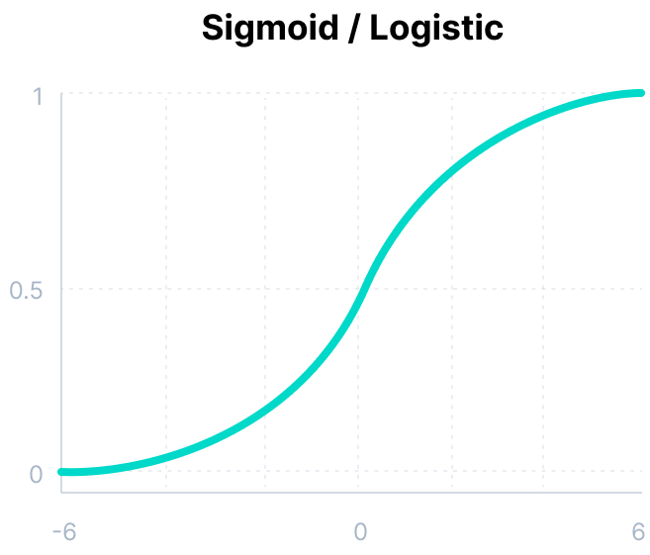
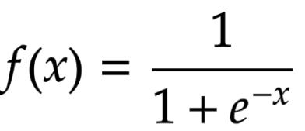
Cont.
Sigmoid / Logistic Activation Function:
This function takes any real value as input and outputs values in the range of 0 to 1
The larger the input (more positive), the closer the output value will be to 1., whereas the smaller the input (more negative), the closer the output will be to 0
It is commonly used for models where we have to predict the probability as an output.
Since probability of anything exists only between the range of 0 and 1, sigmoid is the right choice because of its range.
The function is differentiable and provides a smooth gradient, i.e., preventing jumps in output values.
This is represented by an S-shape of the sigmoid activation function.
Mathematically it can be represented as:

Slide 21
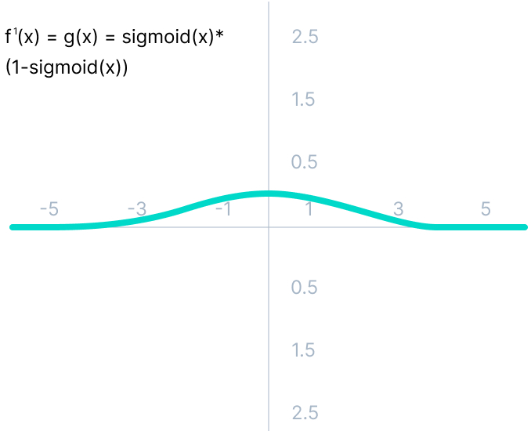
Cont.
The limitations of sigmoid function:
As we can see from the given Figure, the gradient values are only significant for range -3 to 3, and the graph gets much flatter in other regions.
It implies that for values greater than 3 or less than -3, the function will have very small gradients. As the gradient value approaches zero, the network ceases to learn and suffers from the Vanishing gradient problem.
The output of the logistic function is not symmetric around zero. So the output of all the neurons will be of the same sign. This makes the training of the neural network more difficult and unstable.

Slide 22
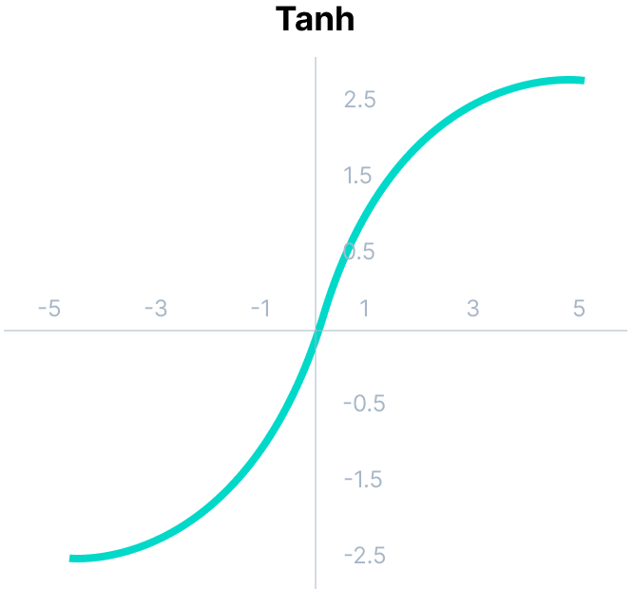
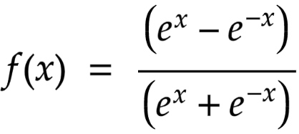
Cont.
Tanh Function (Hyperbolic Tangent):
Tanh function is very similar to the sigmoid/logistic activation function, and even has the same S-shape with the difference in output range of -1 to 1.
In Tanh, the larger the input (more positive), the closer the output value will be to 1.0, whereas the smaller the input (more negative), the closer the output will be to -1.0.
The output of the tanh activation function is Zero centered; hence we can easily map the output values as strongly negative, neutral, or strongly positive.
Usually used in hidden layers of a neural network as its values lie between -1 to; therefore, the mean for the hidden layer comes out to be 0 or very close to it. It helps in centering the data and makes learning for the next layer much easier.
Mathematically it can be represented as:

Slide 23
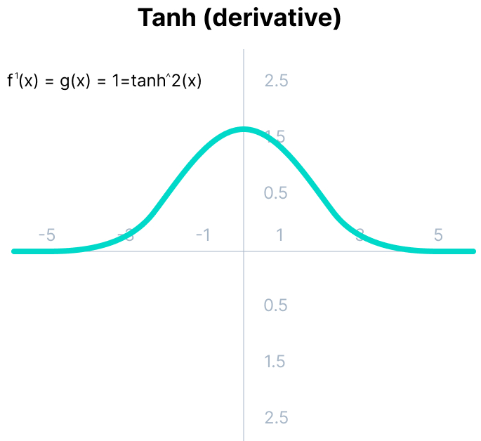
Cont.
tanh activation function limitations:
it also faces the problem of vanishing gradients similar to the sigmoid activation function.
Plus the gradient of the tanh function is much steeper as compared to the sigmoid function.

Slide 24
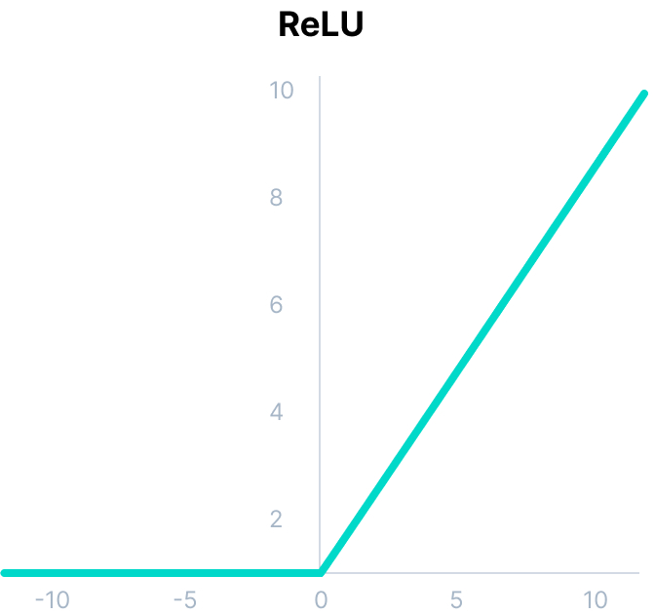
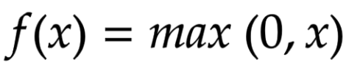
Cont.
ReLU Activation Function:
ReLU stands for Rectified Linear Unit.
Although it gives an impression of a linear function, ReLU has a derivative function and allows for backpropagation while simultaneously making it computationally efficient.
The main catch here is that the ReLU function does not activate all the neurons at the same time.
The neurons will only be deactivated if the output of the linear transformation is less than 0.
Since only a certain number of neurons are activated, the ReLU function is far more computationally efficient when compared to the sigmoid and tanh functions.
ReLU accelerates the convergence of gradient descent towards the global minimum of the loss function due to its linear, non-saturating property.
Mathematically it can be represented as:

Slide 25
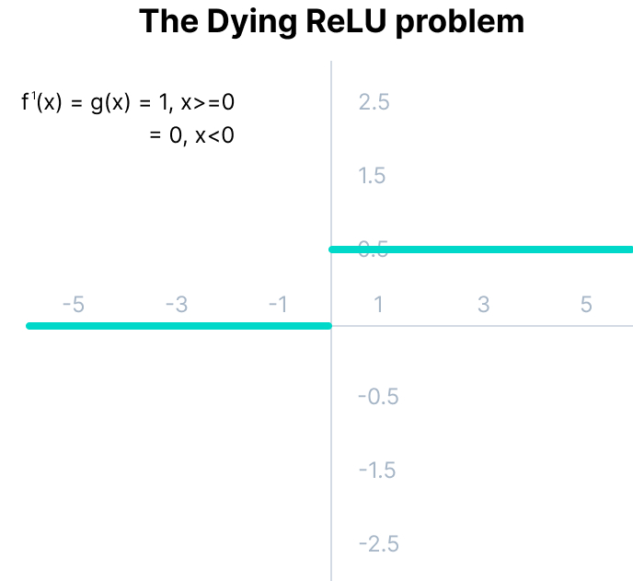
Cont.
The limitations faced by this function are: The Dying ReLU problem:
The negative side of the graph makes the gradient value zero. Due to this reason, during the backpropagation process, the weights and biases for some neurons are not updated. This can create dead neurons which never get activated.
All the negative input values become zero immediately, which decreases the model’s ability to fit or train from the data properly.

Slide 26
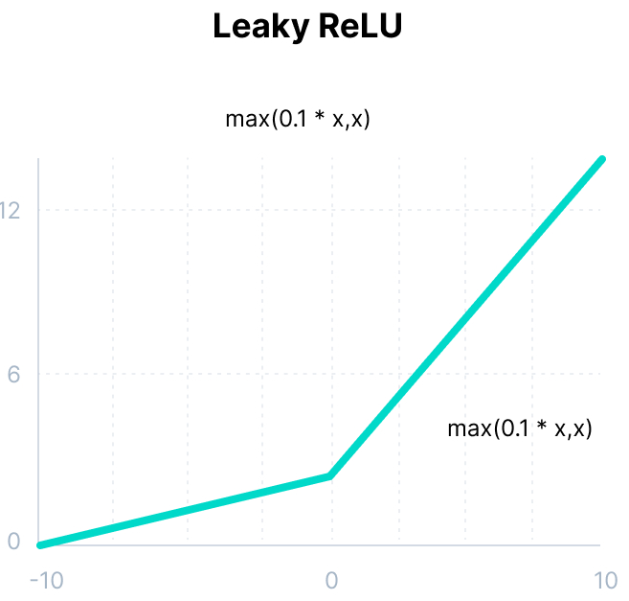
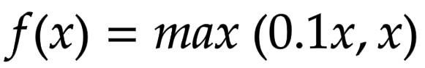
Cont.
Leaky ReLU Function:
Leaky ReLU is an improved version of ReLU function to solve the Dying ReLU problem as it has a small positive slope in the negative area.
The advantages of Leaky ReLU are same as that of ReLU, in addition to the fact that it does enable backpropagation, even for negative input values.
By making this minor modification for negative input values, the gradient of the left side of the graph comes out to be a non-zero value. Therefore, we would no longer encounter dead neurons in that region.
Mathematically it can be represented as:

Slide 27
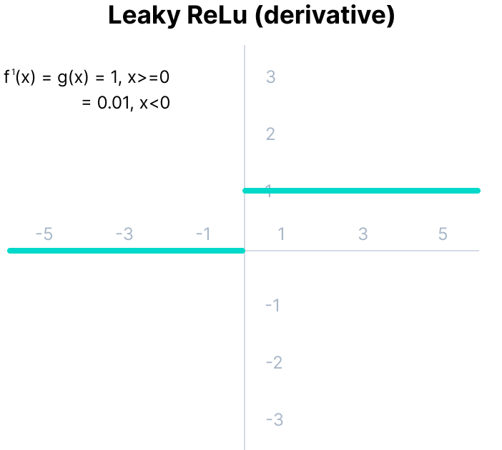
Cont.
The limitations that this function faces include:
The predictions may not be consistent for negative input values.
The gradient for negative values is a small value that makes the learning of model parameters time-consuming.

Slide 28
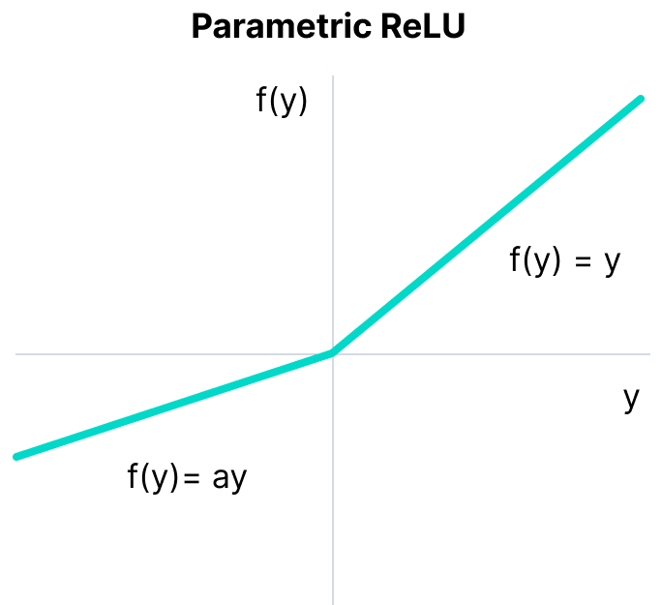
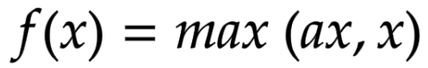
Cont.
Parametric ReLU Function:
Parametric ReLU is another variant of ReLU that aims to solve the problem of gradient’s becoming zero for the left half of the axis.
This function provides the slope of the negative part of the function as an argument a. By performing backpropagation, the most appropriate value of a is learnt.
The parameterized ReLU function is used when the leaky ReLU function still fails at solving the problem of dead neurons, and the relevant information is not successfully passed to the next layer.
This function’s limitation is that it may perform differently for different problems depending upon the value of slope parameter a.
Mathematically it can be represented as:
Where "a" is the slope parameter for negative values.

Slide 29
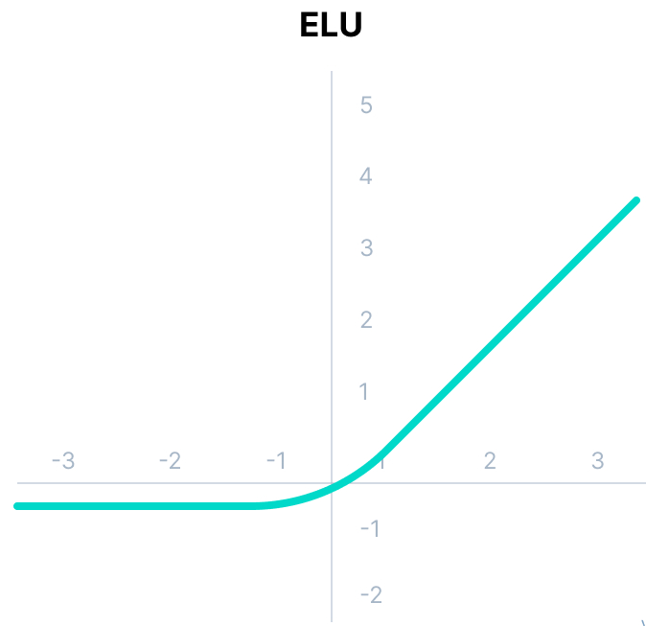
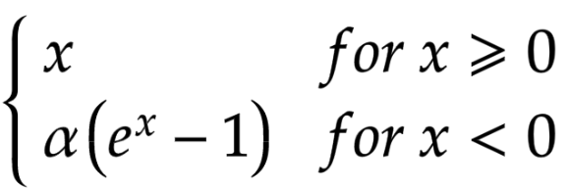
10 Non-Linear Neural Networks Activation Functions
Exponential Linear Units (ELUs) Activation Function :
Exponential Linear Unit, or ELU for short, is also a variant of ReLU that modifies the slope of the negative part of the function.
ELU uses a log curve to define the negativ values unlike the leaky ReLU and Parametric ReLU functions with a straight line.
ELU becomes smooth slowly until its output equal to -α whereas RELU sharply smoothes.
Avoids dead ReLU problem by introducing log curve for negative values of input. It helps the network nudge weights and biases in the right direction.
Mathematically it can be represented as:

Slide 30
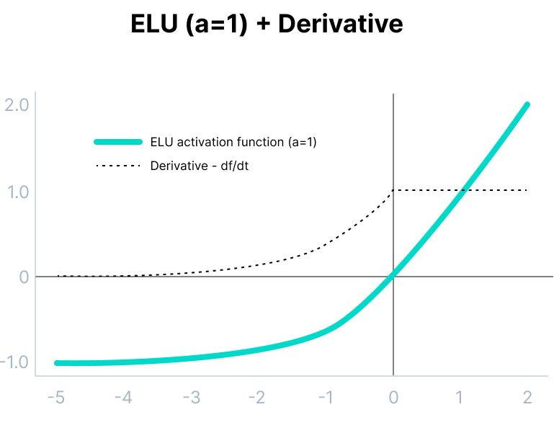
Cont.
The limitations of the ELU function are as follow:
It increases the computational time because of the exponential operation included
No learning of the ‘a’ value takes place
Exploding gradient problem

Slide 31
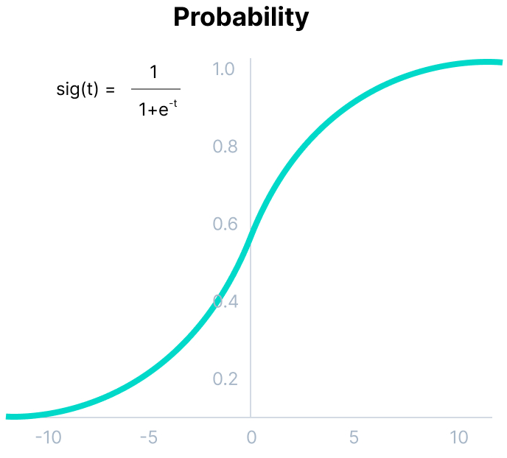
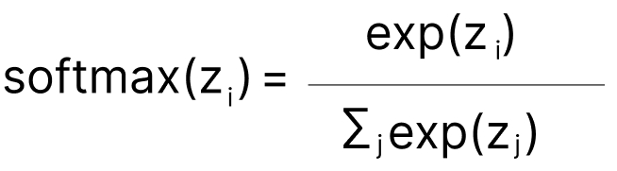
Cont.
Softmax Function:
Softmax function is described as a combination of multiple sigmoids.
It calculates the relative probabilities. Similar to the sigmoid/logistic activation function, the SoftMax function returns the probability of each class.
It is most commonly used as an activation function for the last layer of the neural network in the case of multi-class classification.
Assume three classes, output from the neurons is [1.8, 0.9, 0.68].
Applying the softmax : [0.58, 0.23, 0.19].
The function returns 1 for the largest probability index while it returns 0 for the other two array indexes. Here, giving full weight to index 0 and no weight to index 1 and index 2. So the output would be the class corresponding to the 1st neuron(index 0) out of three.
Mathematically it can be represented as:

Slide 32
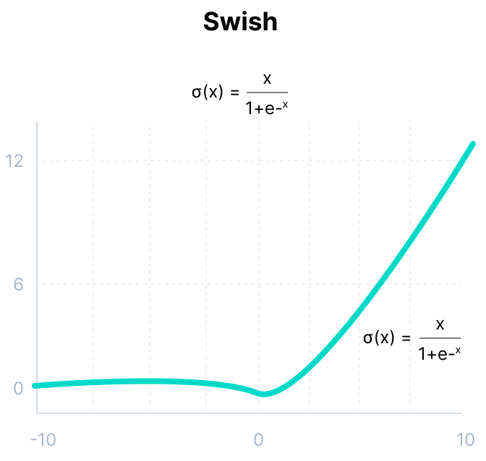
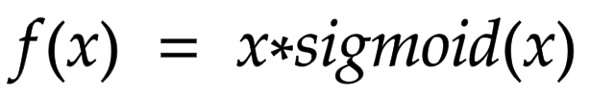
Cont.
Swish:
It is a self-gated activation function developed by researchers at Google. Swish consistently matches or outperforms ReLU activation function on deep networks applied to various challenging domains such as image classification, machine translation etc.
This function is bounded below but unbounded above i.e. Y approaches to a constant value as X approaches negative infinity but Y approaches to infinity as X approaches infinity.
Swish is a smooth function that means that it does not abruptly change direction like ReLU does near x = 0. Rather, it smoothly bends from 0 towards values < 0 and then upwards again.
Small negative values were zeroed out in ReLU activation function. However, those negative values may still be relevant for capturing patterns underlying the data. Large negative values are zeroed out for reasons of sparsity making it a win-win situation.
Mathematically it can be represented as:

Slide 33
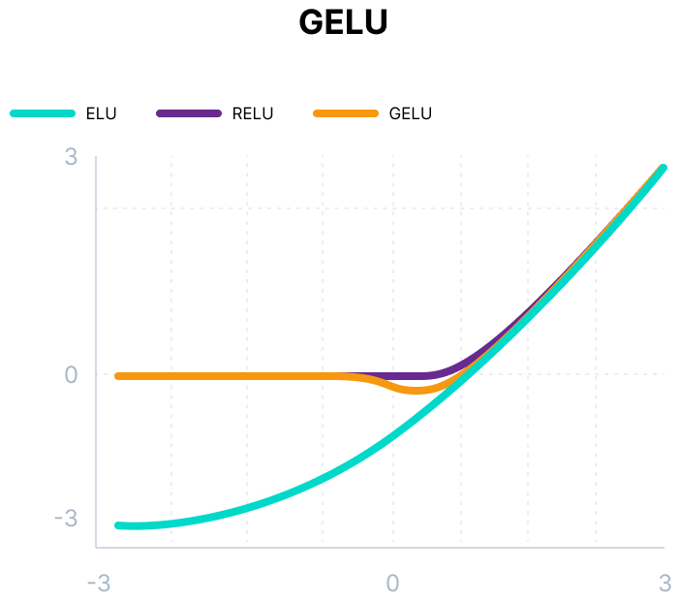
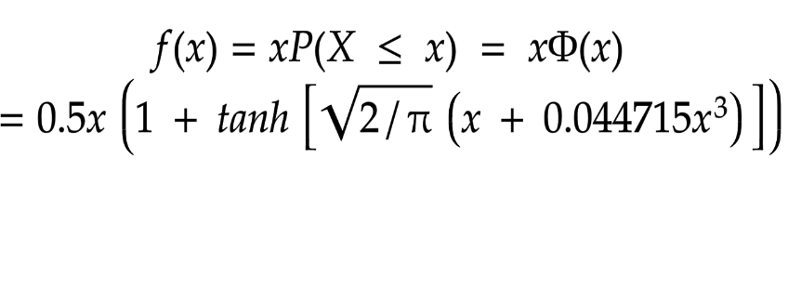
Cont.
Gaussian Error Linear Unit (GELU):
The Gaussian Error Linear Unit (GELU) activation function is compatible with BERT, ROBERTa, ALBERT, and other top NLP models. This activation function is motivated by combining properties from dropout, zoneout, and ReLUs.
ReLU and dropout together yield a neuron’s output. ReLU does it deterministically by multiplying the input by zero or one (depending upon the input value being positive or negative) and dropout stochastically multiplying by zero.
RNN regularizer called zoneout stochastically multiplies inputs by one.
Mathematically it can be represented as:

Slide 34
Cont.
We merge this functionality by multiplying the input by either zero or one which is stochastically determined and is dependent upon the input.
We multiply the neuron input x by m ∼ Bernoulli(Φ(x)), where Φ(x) = P(X ≤x), X ∼ N (0, 1) is the cumulative distribution function of the standard normal distribution.
This distribution is chosen since neuron inputs tend to follow a normal distribution, especially with Batch Normalization.
GELU nonlinearity is better than ReLU and ELU activations and finds performance improvements across all tasks in domains of computer vision, natural language processing, and speech recognition.

Slide 35
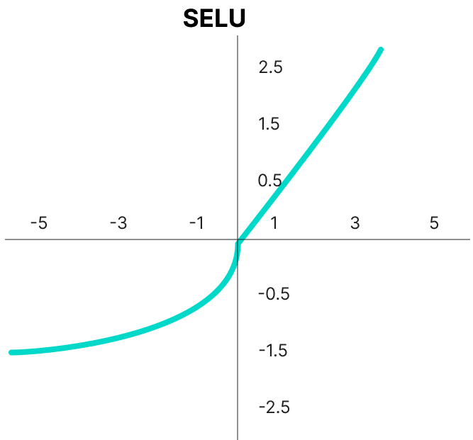
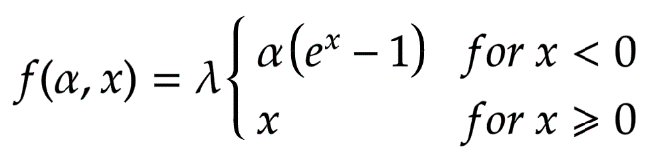
Cont.
Scaled Exponential Linear Unit (SELU):
SELU was defined in self-normalizing networks and takes care of internal normalization which means each layer preserves the mean and variance from the previous layers.
SELU enables this normalization by adjusting the mean and variance
SELU has both positive and negative values to shift the mean, which was impossible for ReLU activation function as it cannot output negative values.
Gradients can be used to adjust the variance. The activation function needs a region with a gradient larger than one to increase it.
Mathematically it can be represented as:

Slide 36
Cont.
Scaled Exponential Linear Unit (SELU):
SELU was defined in self-normalizing networks and takes care of internal normalization which means each layer preserves the mean and variance from the previous layers.
SELU enables this normalization by adjusting the mean and variance
SELU has both positive and negative values to shift the mean, which was impossible for ReLU activation function as it cannot output negative values.
Gradients can be used to adjust the variance. The activation function needs a region with a gradient larger than one to increase it.
Mathematically it can be represented as:
SELU has values of alpha α and lambda λ predefined.

Slide 37
Cont.
Here’s the main advantage of SELU over ReLU:
Internal normalization is faster than external normalization, which means the network converges faster.
SELU is a relatively newer activation function and needs more papers on architectures such as CNNs and RNNs, where it is comparatively explored.

Slide 38
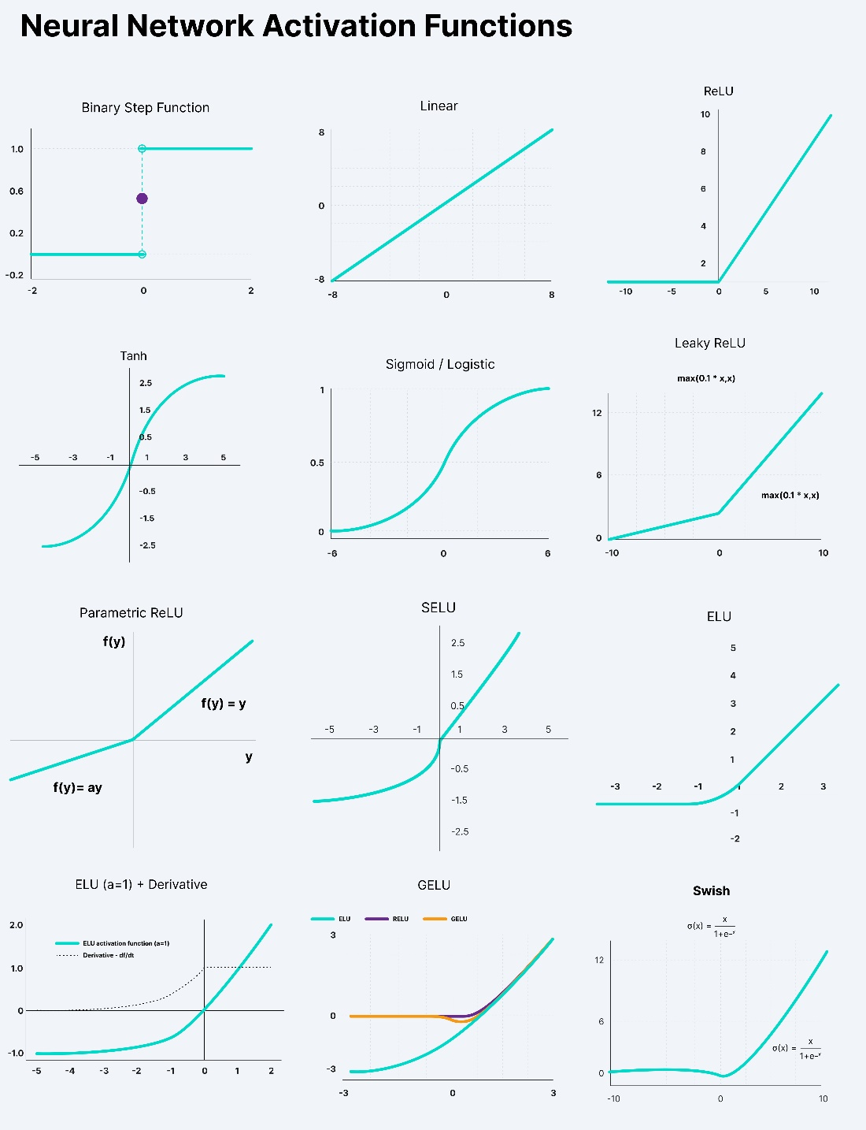
Cheatsheet Neural Network Activation Functions

Slide 39
Why are deep neural networks hard to train?
There are two challenges you might encounter when training your deep neural networks:
Vanishing Gradients:
Like the sigmoid function, certain activation functions squish a sample input space into a small output space between 0 and 1.
Therefore, a large change in the input of the sigmoid function will cause a small change in the output. Hence, the derivative becomes small. For shallow networks with only a few layers that use these activations, this isn’t a big problem.
However, when more layers are used, it can cause the gradient to be too small for training to work effectively.
Exploding Gradients:
Exploding gradients are problems where significant error gradients accumulate and result in very large updates to neural network model weights during training.
An unstable network can result when there are exploding gradients, and the learning cannot be completed.
The values of the weights can also become so large as to overflow and result in something called NaN values.

Slide 40
How to choose the right Activation Function?
You need to match your activation function for your output layer based on the type of prediction problem that you are solving—specifically, the type of predicted variable.
As a rule of thumb, you can begin with using the ReLU activation function and then move over to other activation functions if ReLU doesn’t provide optimum results.
And here are a few other guidelines to help you out:
ReLU activation function should only be used in the hidden layers.
Sigmoid/Logistic and Tanh functions should not be used in hidden layers as they make the model more susceptible to problems during training (due to vanishing gradients).
Swish function is used in neural networks having a depth greater than 40 layers.
Finally, a few rules for choosing the activation function for your output layer based on the type of prediction problem that you are solving:
Regression - Linear Activation Function
Binary Classification - Sigmoid/Logistic Activation Function
Multiclass Classification - Softmax
Multilabel Classification - Sigmoid

Slide 41
Cont.
The activation function used in hidden layers is typically chosen based on the type of neural network architecture:
Convolutional Neural Network (CNN): ReLU activation function.
Recurrent Neural Network (RNN): Tanh and/or Sigmoid activation function.

Slide 42
Well done!
You’ve made it this far ;-) Now, let’s have a quick recap of everything you’ve learnt in this lecture:
Activation Functions are used to introduce non-linearity in the network.
A neural network will almost always have the same activation function in all hidden layers. This activation function should be differentiable so that the parameters of the network are learned in backpropagation.
ReLU is the most commonly used activation function for hidden layers.
While selecting an activation function, you must consider the problems it might face: vanishing and exploding gradients.
Regarding the output layer, we must always consider the expected value range of the predictions. If it can be any numeric value (as in case of the regression problem) you can use the linear activation function or ReLU.
Use Softmax or Sigmoid function for the classification problems.

Slide 43
Overview:
This slide is divided into four sections:
The Multilayer Perceptron
How to Count Layers?
Why Have Multiple Layers?
How Many Layers and Nodes to Use?

Slide 44
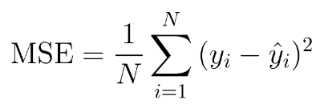
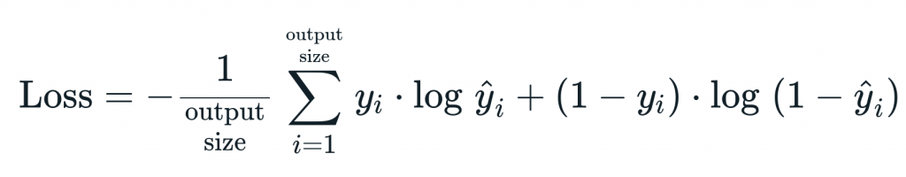
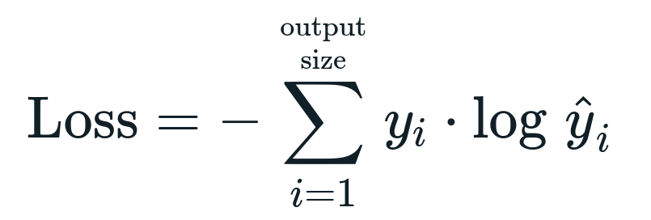
Loss Calculation/Error:
Mean Squared Error Loss: Regression Problem (A problem where you predict a real-value quantity.)
Cross-Entropy Loss (or Log Loss): Binary Classification/ Multi Classification Problem (A problem where you classify an example as belonging to one of more than two classes.)
Binary cross-entropy:
Categorical cross-entropy:

Slide 45
Cont.:
Sparse categorical cross-entropy:
When using cross-entropy with classification problems with a large number of labels like the 1000 classes.
This can mean that the target element of each training example may require a one-hot encoded vector with thousands of zero values, requiring significant memory

Slide 46
Cont.:
Sparse categorical cross-entropy:
When using cross-entropy with classification problems with a large number of labels like the 1000 classes.
This can mean that the target element of each training example may require a one-hot encoded vector with thousands of zero values, requiring significant memory

Slide 47
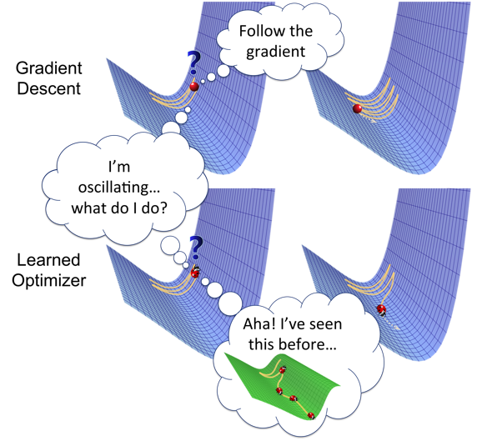
Weights updates (optimizer)
Optimizers are algorithms or methods used to change the attributes of your neural network such as weights and learning rate in order to reduce the losses
How you should change your weights or learning rates of your neural network to reduce the losses is defined by the optimizers you use. Optimization algorithms or strategies are responsible for reducing the losses and to provide the most accurate results possible
Notes:
https://towardsdatascience.com/optimizers-for-training-neural-network-59450d71caf6

Slide 48
Cont.:
Gradient Descent:
Gradient Descent is the most basic but most used optimization algorithm.
It’s used heavily in linear regression and classification algorithms.
Backpropagation in neural networks also uses a gradient descent algorithm
Gradient descent is a first-order optimization algorithm which is dependent on the first order derivative of a loss function.
It calculates that which way the weights should be altered so that the function can reach a minima.
Through backpropagation, the loss is transferred from one layer to another and the model’s parameters also known as weights are modified depending on the losses so that the loss can be minimized.
algorithm: θ=θ−α⋅∇J(θ)
Advantages:
Easy computation.
Easy to implement.
Easy to understand.
Disadvantages:
May trap at local minima.
Weights are changed after calculating gradient on the whole dataset. So, if the dataset is too large than this may take years to converge to the minima.
Requires large memory to calculate gradient on the whole dataset.

Slide 49
Cont.:
Stochastic Gradient Descent
It’s a variant of Gradient Descent. It tries to update the model’s parameters more frequently.
In this, the model parameters are altered after computation of loss on each training example. So, if the dataset contains 1000 rows SGD will update the model parameters 1000 times in one cycle of dataset instead of one time as in Gradient Descent.
θ=θ−α⋅∇J(θ;x(i);y(i)) , where {x(i) ,y(i)} are the training examples.
As the model parameters are frequently updated parameters have high variance and fluctuations in loss functions at different intensities.
Advantages:
Frequent updates of model parameters hence, converges in less time.
Requires less memory as no need to store values of loss functions.
May get new minima’s.
Disadvantages:
High variance in model parameters.
May shoot even after achieving global minima.
To get the same convergence as gradient descent needs to slowly reduce the value of learning rate.

Slide 50
Cont.:
Mini-Batch Gradient Descent
It’s best among all the variations of gradient descent algorithms.
It is an improvement on both SGD and standard gradient descent.
It updates the model parameters after every batch. So, the dataset is divided into various batches and after every batch, the parameters are updated.
θ=θ−α⋅∇J(θ; B(i)), where {B(i)} are the batches of training examples.
Advantages:
Frequently updates the model parameters and also has less variance.
Requires medium amount of memory.
All types of Gradient Descent have some challenges:
Choosing an optimum value of the learning rate. If the learning rate is too small than gradient descent may take ages to converge.
Have a constant learning rate for all the parameters. There may be some parameters which we may not want to change at the same rate.
May get trapped at local minima.

Slide 51
Cont.:
Momentum
Momentum was invented for reducing high variance in SGD and softens the convergence.
It accelerates the convergence towards the relevant direction and reduces the fluctuation to the irrelevant direction.
One more hyperparameter is used in this method known as momentum symbolized by ‘γ’.
V(t)=γV(t−1)+α.∇J(θ)
Now, the weights are updated by θ=θ−V(t).
The momentum term γ is usually set to 0.9 or a similar value.
Advantages:
Reduces the oscillations and high variance of the parameters.
Converges faster than gradient descent.
Disadvantages:
One more hyper-parameter is added which needs to be selected manually and accurately.

Slide 52
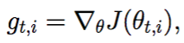
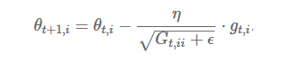
Cont.:
Adagrad
One of the disadvantages of all the optimizers explained is that the learning rate is constant for all parameters and for each cycle.
This optimizer changes the learning rate.
It changes the learning rate ‘η’ for each parameter and at every time step ‘t’.
It’s a type second order optimization algorithm. It works on the derivative of an error function
η is a learning rate which is modified for given parameter θ(i) at a given time based on previous gradients calculated for given parameter θ(i).
We store the sum of the squares of the gradients w.r.t. θ(i) up to time step t, while ϵ is a smoothing term that avoids division by zero (usually on the order of 1e−8). Interestingly, without the square root operation, the algorithm performs much worse.
It makes big updates for less frequent parameters and a small step for frequent parameters.
A derivative of loss function for given parameters at a given time t.
Update parameters for given input i and at time/iteration t

Slide 53
Cont.:
Advantages:
Learning rate changes for each training parameter.
Don’t need to manually tune the learning rate.
Able to train on sparse data.
Disadvantages:
Computationally expensive as a need to calculate the second order derivative.
The learning rate is always decreasing results in slow training.

Slide 54
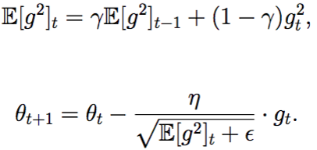
Cont.:
AdaDelta
It is an extension of AdaGrad which tends to remove the decaying learning Rate problem of it. Instead of accumulating all previously squared gradients, Adadelta limits the window of accumulated past gradients to some fixed size w. In this exponentially moving average is used rather than the sum of all the gradients.
E[g²](t)=γ.E[g²](t−1)+(1−γ).g²(t)
We set γ to a similar value as the momentum term, around 0.9.
Update the parameters =

Slide 55
Cont.:
AdaDelta
It is an extension of AdaGrad which tends to remove the decaying learning Rate problem of it. Instead of accumulating all previously squared gradients, Adadelta limits the window of accumulated past gradients to some fixed size w. In this exponentially moving average is used rather than the sum of all the gradients.
E[g²](t)=γ.E[g²](t−1)+(1−γ).g²(t)
We set γ to a similar value as the momentum term, around 0.9.
Update the parameters =

Slide 56
Cont.:
Advantages:
Now the learning rate does not decay and the training does not stop.
Disadvantages:
Computationally expensive.

Slide 57
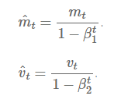
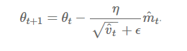
Cont.:
Adam
Adam (Adaptive Moment Estimation) works with momentums of first and second order. The intuition behind the Adam is that we don’t want to roll so fast just because we can jump over the minimum, we want to decrease the velocity a little bit for a careful search. In addition to storing an exponentially decaying average of past squared gradients like AdaDelta, Adam also keeps an exponentially decaying average of past gradients M(t).
M(t) and V(t) are values of the first moment which is the Mean and the second moment which is the uncentered variance of the gradients respectively.
First and second order of momentum =
Here, we are taking mean of M(t) and V(t) so that E[m(t)] can be equal to E[g(t)] where, E[f(x)] is an expected value of f(x).
To update the parameter:
he values for β1 is 0.9 , 0.999 for β2, and (10 x exp(-8)) for ‘ϵ’.

Slide 58
Cont.:
Advantages:
The method is too fast and converges rapidly.
Rectifies vanishing learning rate, high variance.
Disadvantages:
Computationally costly.

Slide 59
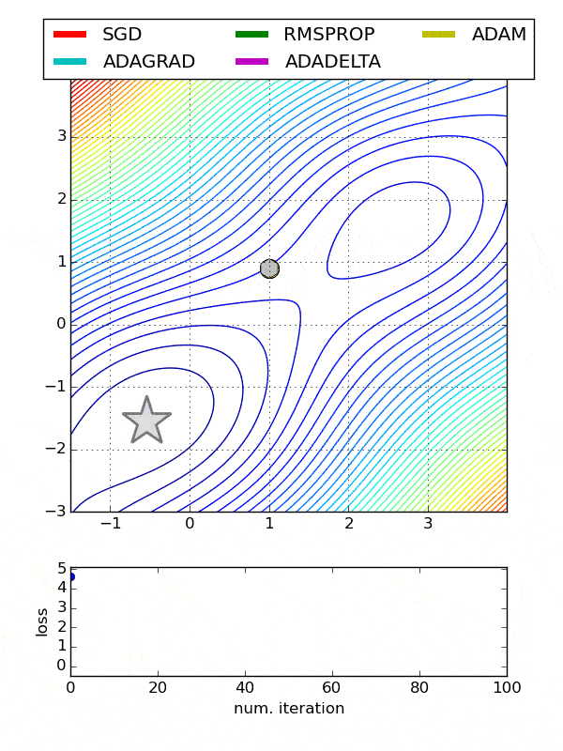
Comparison between various optimizers
Adam is the best optimizers. If one wants to train the neural network in less time and more efficiently than Adam is the optimizer.
For sparse data use the optimizers with dynamic learning rate.
If, want to use gradient descent algorithm than min-batch gradient descent is the best option.
I hope you guys liked the article and were able to give you a good intuition towards the different behaviors of different Optimization Algorithms.

Slide 60
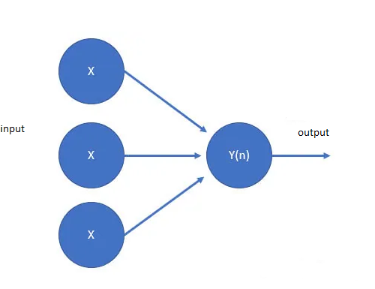
The Single Layer Perceptron:
A node, also called a neuron or Perceptron, is a computational unit that has one or more weighted input connections, a transfer function that combines the inputs in some way, and an output connection.
Nodes are then organized into layers to comprise a network.
A single-layer artificial neural network, also called a single-layer, has a single layer of nodes, as its name suggests. Each node in the single layer connects directly to an input variable and contributes to an output variable
Single-layer networks have just one layer of active units. Inputs connect directly to the outputs through a single layer of weights. The outputs do not interact, so a network with N outputs can be treated as N separate single-output networks.

Slide 61

The Multi Layer Perceptron:
The standard multilayer perceptron (MLP) is a cascade of single-layer perceptrons. There is a layer of input nodes, a layer of output nodes, and one or more intermediate layers. The interior layers are sometimes called “hidden layers” because they are not directly observable from the systems inputs and outputs.
Input Layer: Input variables, sometimes called the visible layer.
Hidden Layers: Layers of nodes between the input and output layers. There may be one or more of these layers.
Output Layer: A layer of nodes that produce the output variables.

Slide 62
Cont.
There are terms used to describe the shape and capability of a neural network:
Size: The number of nodes in the model.
Width: The number of nodes in a specific layer.
Depth: The number of layers in a neural network.
Capacity: The type or structure of functions that can be learned by a network configuration. Sometimes called “representational capacity“.
Architecture: The specific arrangement of the layers and nodes in the network.

Slide 63
How to Count Layers?
A network with two variables in the input layer, one hidden layer with eight nodes, and an output layer with one node would be described using the notation:
2/8/1

Slide 64
Why Have Multiple Layers?
A single-layer neural network can only be used to represent linearly separable functions. This means very simple problems where, say, the two classes in a classification problem can be neatly separated by a line. If your problem is relatively simple, perhaps a single layer network would be sufficient.
Most problems that we are interested in solving are not linearly separable
A Multilayer Perceptron can be used to represent convex regions. This means that in effect, they can learn to draw shapes around examples in some high-dimensional space that can separate and classify them, overcoming the limitation of linear separability.

Slide 65
How Many Layers and Nodes to Use?
In general, you cannot analytically calculate the number of layers or the number of nodes to use per layer in an artificial neural network to address a specific real-world predictive modeling problem.
Five approaches to solving this problem:
Experimentation:
In general, you cannot analytically calculate the number of layers or the number of nodes to use per layer in an artificial neural network to address a specific real-world predictive modeling problem.
The number of layers and the number of nodes in each layer are model hyperparameters that are using.
Intuition:
This intuition can come from experience with the domain, experience with modeling problems with neural networks, or some mixture of the two.
In my experience, intuitions are often invalidated via experiments.

Slide 66
Cont.
Go For Depth:
This is similar to the advice for starting with Random Forest and Stochastic Gradient Boosting on a predictive modeling problem with tabular data to quickly get an idea of an upper-bound on model skill prior to testing other methods.
Borrow Ideas:
A simple, but perhaps time consuming approach, is to leverage findings reported in the literature.
Search:
Design a search method to test different network configurations.
Search strategies include:-
Random: Try random configurations of layers and nodes per layer.
Grid: Try a systematic search across the number of layers and nodes per layer.
Heuristic: Try a directed search across configurations such as a genetic algorithm or Bayesian optimization.
Exhaustive: Try all combinations of layers and the number of nodes; it might be feasible for small networks and datasets.

Slide 67
Layers
INPUT_SHAPE = (samples,sweeps,1) #change to (207,45,1)
model = Sequential()
model.add(Conv2D(32, (3, 3), input_shape = INPUT_SHAPE, activation='relu'))
model.add(MaxPooling2D(pool_size = (2, 2)))
model.add(Dropout(0.5))
model.add(Conv2D(64, (3, 3), activation='relu'))
model.add(MaxPooling2D(pool_size = (2, 2)))
model.add(Dropout(0.5))
model.add(Conv2D(128, (3, 3), activation='relu'))
model.add(MaxPooling2D(pool_size = (2, 2)))
model.add(Dropout(0.5))
model.add(Flatten())
model.add(Dense(128, activation = 'relu'))
model.add(Dense(len(classes), activation = 'softmax')

Slide 68
Tarining
model.compile(loss='binary_crossentropy',
optimizer='adam', #also try adam,rmsprop, SGD(lr=0.0001, momentum=0.9), ada
metrics=['accuracy'])
es=EarlyStopping(monitor='val_loss', mode='min', verbose=1, patience=200)
mc = ModelCheckpoint('gestures.h5', monitor='val_accuracy', mode='max', verbose=1, save_best_only=True)
history = model.fit(X_train,
y_train,
batch_size = 64,
verbose = 1,
epochs =500 ,
validation_data=(X_test,y_test),
shuffle = False,
callbacks=[es,mc]
)

Slide 69
Results
Epoch 00500: val_accuracy did not improve from 0.96703
12/12 [==============================] - 0s 22ms/step - loss: 0.1164 - accuracy: 0.9394
Test loss: 0.11635447204113007
Test accuracy: 0.94444417953491

Slide 70


Graphs on Current Config.

Slide 71

Confusion matrix of x_prediction and Y_test

Slide 72

Flase prediction

Slide 73

dataset.shape=(451, 207, 45, 1)

Slide 74
Layer | Activation shape ((i-k+2p)s) +1 | Activation size W*h*d | Parameters Width filter*height of filter* no of filters in previous layer + 1 * no of filters
=======================================================================================================
input (207, 45, 1) (9315) 0 (non learnable)
_________________________________________________________________
conv2d( f=3, s=1) (205, 43, 32) (282080) 320
_________________________________________________________________
max_pooling (f=2) (102, 21, 32) (68544) 0 (non learnable but used )
_________________________________________________________________
dropout (.5) (102, 21, 32) (6502) 0 (non learnable)
_________________________________________________________________
conv2d (100, 19, 64) (121600) 18496
________________________________________________________________
max_pooling (50, 9, 64) (28800) 0
_________________________________________________________________
dropout (50, 9, 64) (28656) 0
_________________________________________________________________
conv2d (48, 7, 128) (43008) 73856
_________________________________________________________________
max_pooling (24, 3, 128) (9216) 0
_________________________________________________________________
dropout (24, 3, 128) (9169) 0
_________________________________________________________________
flatten (9216) (9116) 0
_________________________________________________________________
dense (128) (128) 1179776 ( because every neuron connected to other neuron)
_________________________________________________________________
dense (3) (3) 387
=================================================================
Total params: 1,272,835
Trainable params: 1,272,835
Non-trainable params: 0
Notes:
https://towardsdatascience.com/understanding-and-calculating-the-number-of-parameters-in-convolution-neural-networks-cnns-fc88790d530d

